Slide 1
Coursera Capstone IBM Applied Data Science Capstone Opening a New Shopping Mall in Kuala Lumpur, Malaysia By: SANJAY SIDDHARTH APRIL 2020

Slide 2
Introduction
Shopping malls are like a one-stop destination for all types of shoppers. For retailers, the central location and the large crowd at the shopping malls provides a great distribution channel to market their products and
The objective of this capstone project is to analyse and select the best locations in the city of Kuala
Lumpur, Malaysia to open a new shopping mall. Using data science methodology and machine
learning techniques like clustering, this project aims to provide solutions to answer the business
question: In the city of Kuala Lumpur, Malaysia, if a property developer is looking to open a new
shopping mall, where would you recommend that they open it?
services.

Slide 3
Target Audience of this project
This project is particularly useful to property developers and investors looking to open or invest in
new shopping malls in the capital city of Malaysia i.e. Kuala Lumpur.

Slide 4
DATA
To solve the problem, we will need the following data:
• List of neighbourhoods in Kuala Lumpur. This defines the scope of this project which is
confined to the city of Kuala Lumpur, the capital city of the country of Malaysia in South East
Asia.
• Latitude and longitude coordinates of those neighbourhoods. This is required in order to
plot the map and also to get the venue data.
• Venue data, particularly data related to shopping malls. We will use this data to perform
clustering on the neighbourhoods.

Slide 5
Sources of data and methods to extract them
This Wikipedia page (https://en.wikipedia.org/wiki/Category:Suburbs_in_Kuala_Lumpur) contains a list of neighbourhoods in Kuala Lumpur, with a total of 70 neighbourhoods.
After that, we will use Foursquare API to get the venue data for those neighbourhoods. Foursquare has one of the largest database of 105+ million places and is used by over 125,000 developers.
Foursquare API will provide many categories of the venue data, we are particularly interested in the Shopping Mall category in order to help us to solve the business problem put forward.

Slide 6
RESULTS
The results from the k-means clustering show that we can categorize the neighbourhoods into 3
clusters based on the frequency of occurrence for “Shopping Mall”:
• Cluster 1: Neighbourhoods with moderate number of shopping malls
• Cluster 2: Neighbourhoods with low number to no existence of shopping malls
• Cluster 3: Neighbourhoods with high concentration of shopping malls
The results of the clustering are visualized in the map below with cluster 1 in red colour, cluster 2 in
purple colour, and cluster 3 in mint green colour.

Slide 7
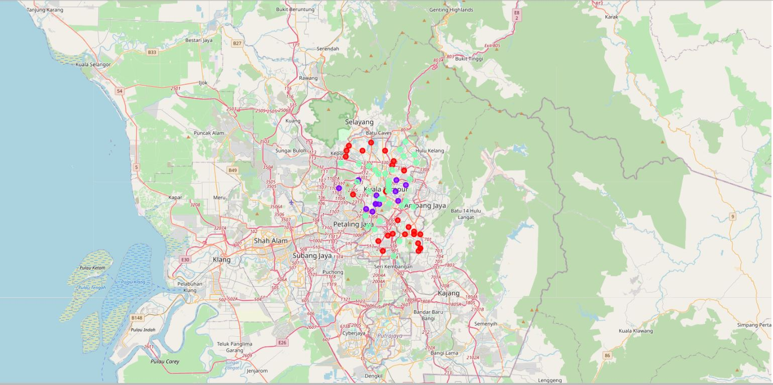
RESULTS

Slide 8
THANK YOU!!

